Slide 1
Python MINI PROJECT SEM – IV Society Management system
Aditi Paretkar – 1911034
Dhruvi Patel – 1911036
Samiksha Shrimali- 1911048

Slide 2
OVERVIEW OF APPLICATION
This mini Project has been designed to manage a society (housing complex)
It will provide easy communication between the stakeholders of the society , such as the tenants and the people who manage it like the secretary and the watchman.
The application provides facility to the tenants to
login/register
Access maintenance / electricity charges
Access notices and access notice for the present day
The application provides facility to the watchman to
Create notices- individual day and general
Contact individual tenants
The application provides facility to secretary to
1. Create maintenance / electricity notices.

Slide 3
Concepts Used
Tkinter module
File Handling
Classes
User defined Exceptions
Regular expressions
Database Connectivity
Module used – Pillow module for adding image

Slide 4
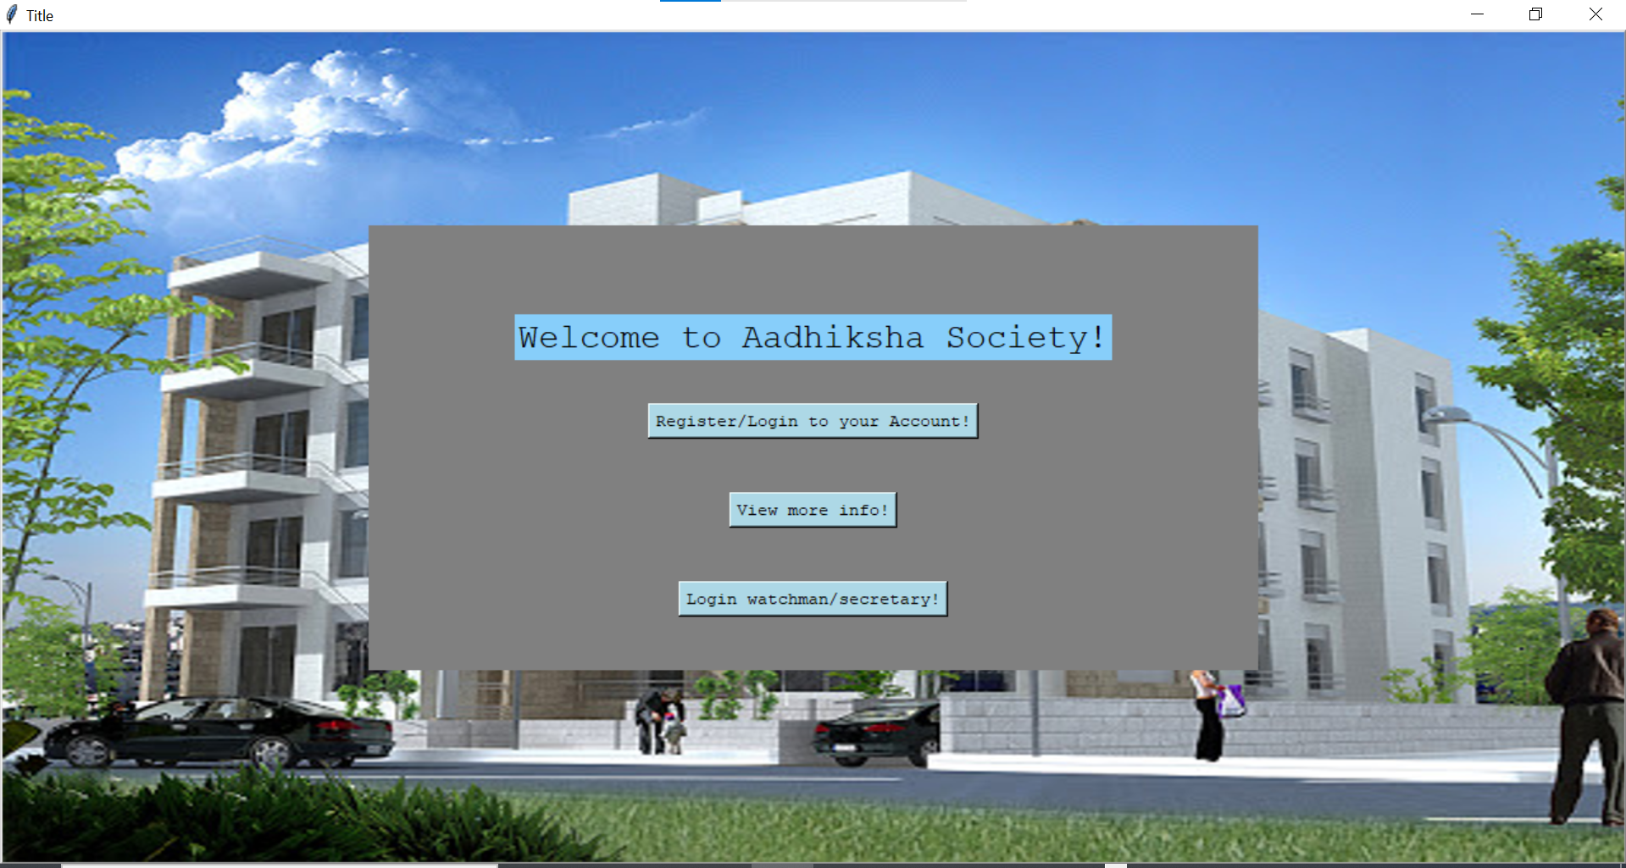
Functionalities (few of them)
1. Main Page

Slide 5
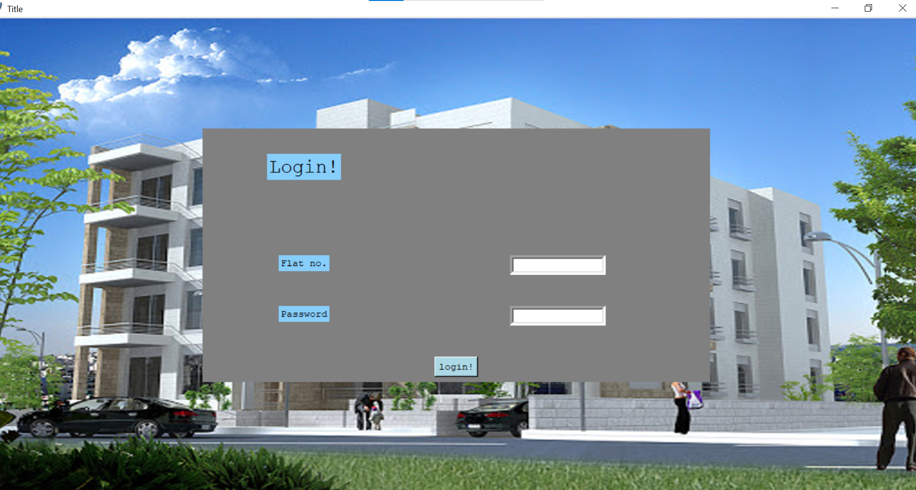
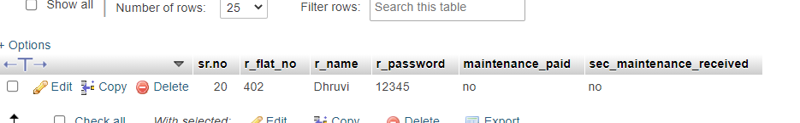
Login by the users: Database:

Slide 6
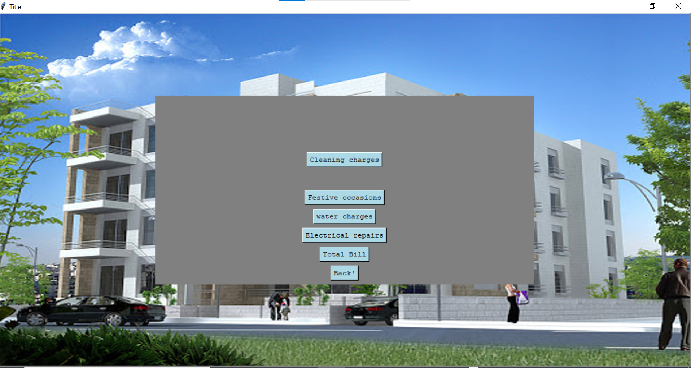
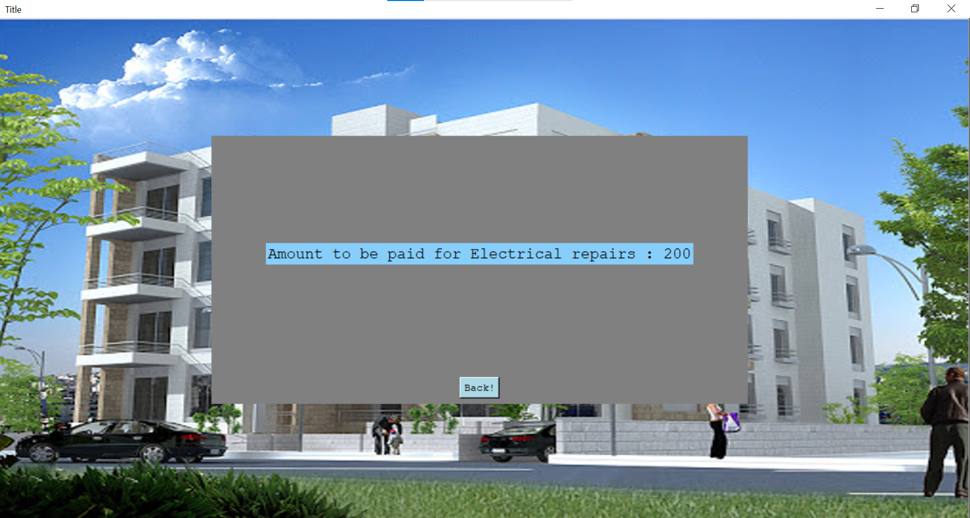
Maintenance facility

Slide 7
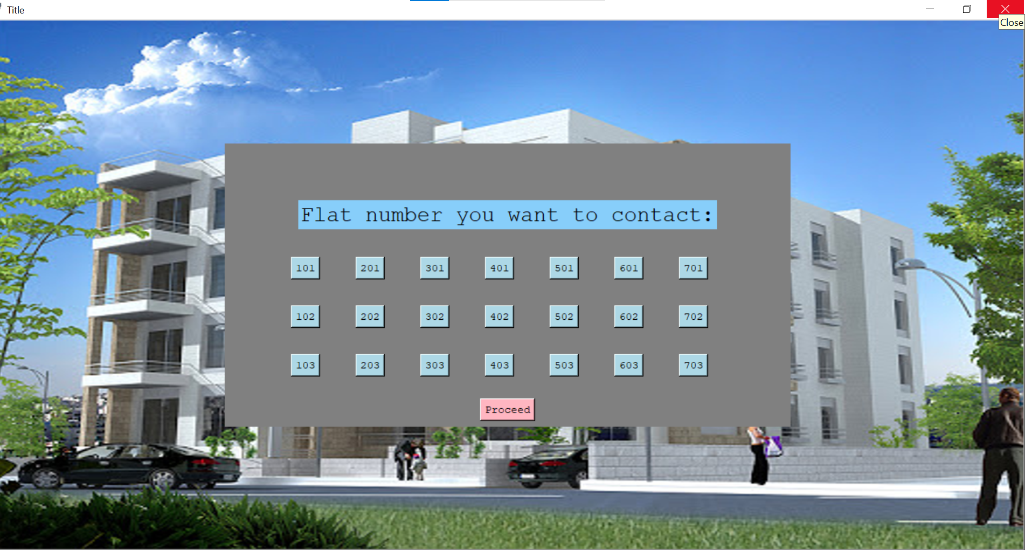
Neat organization of flats

Slide 8
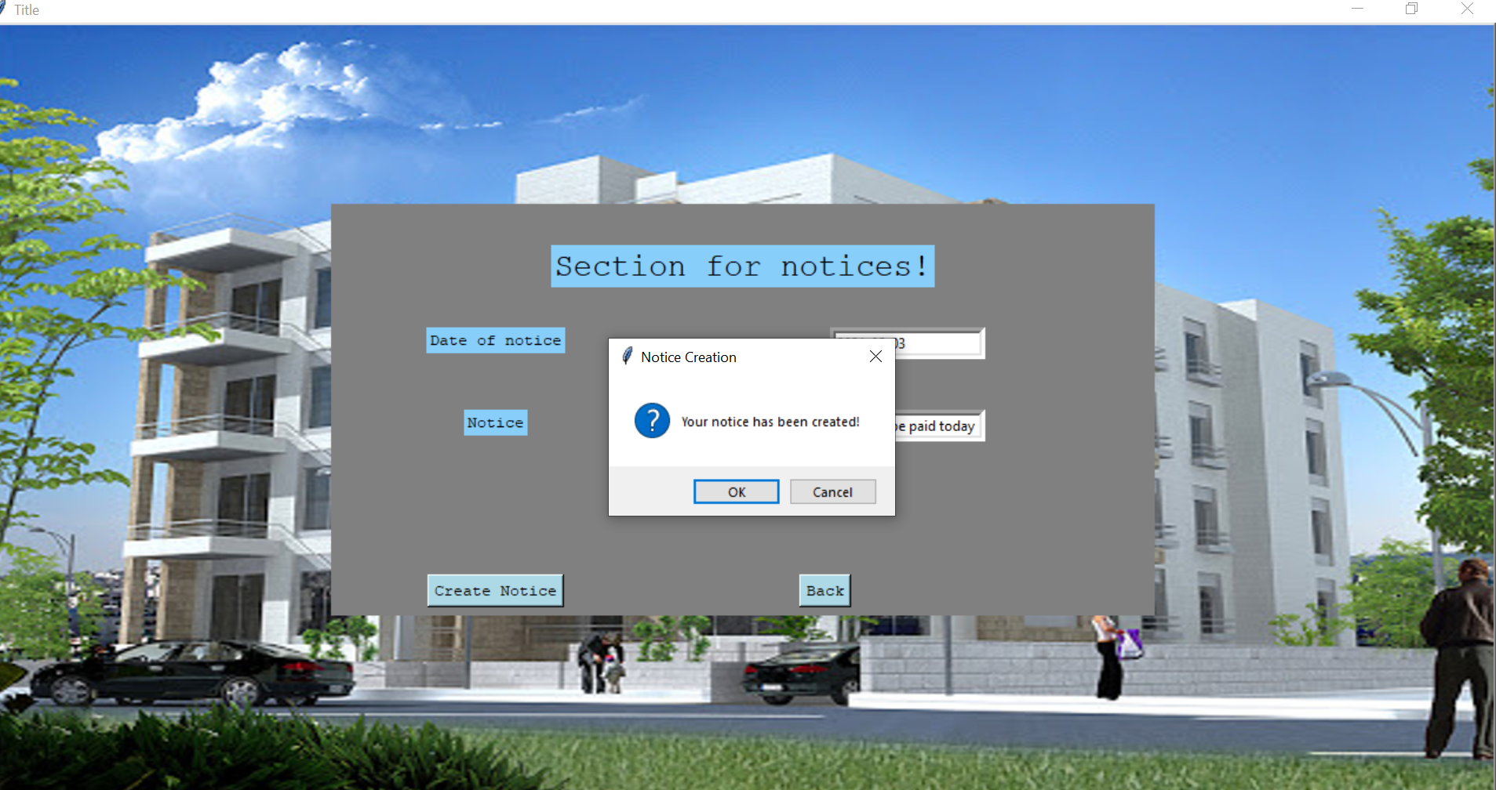
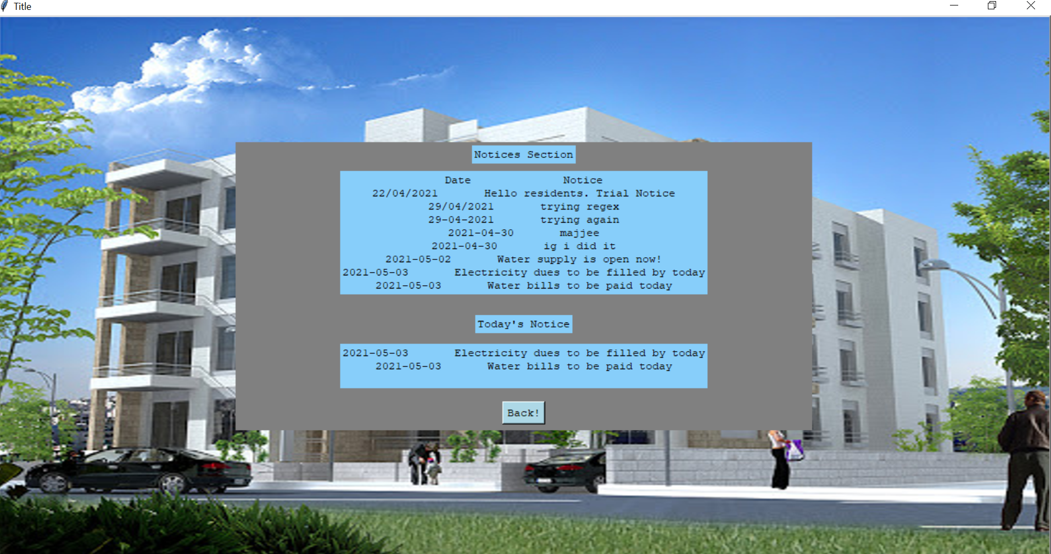
Notices facility : (all and present date):

Slide 9
Github Link
https://github.com/alwaysaditi/Python-Project

Slide 10


